Slide 1
Section 2: Alternative Methods

Slide 2
Fine Tuning
Train Parameters for a specific task (Each task!)
Computationally- and memory-intensive
Can lead to overfitting, forgetting general knowledge
Was the main technique that was used before LoRa

Slide 3
Prefix-Tuning, Prompt Optimization
Adds trainable tokens / learnable prefixes to model input
- E.g, Prompt engineering
Performance non-monotonically changes
i.e, nebulous and unreliable to an extent
Notes:
Prompt engineering, prompt hacking,
You can’t really scale up this technique, and gives limited control with more complex desired outputs.

Slide 4
Adaptor Layers
Insert extra NN layers into architecture that are only trained on the new task.
Similarly has low-number of parameters as LoRa
Creates latency, leading to slower performance.
Notes:
Adding extra layers will obviously make the model more complex,

Slide 5
Quantization
Reduces precision of parameters (e.g, from 32-bit floats to 8-bit or lower)
Reduces memory footprint and speeds up computation
However…Doesn’t actually adapt a model to a new task.
Also potentially reduces accuracy.

Slide 6
Section 3: Mathematical Operation

Slide 7
Low-Rank Parametrized Update Matrices
Idea of Intrinsic Dimension
Representing complex data with as few variables as possible
Can still learn efficiently despite a random projection to a smaller subspace
Hypothesis: Updates to the weights also have low Intrinsic Rank
I.E Focus only on a small number of important parameters
Notes:
NNs have many dense layers which perform matrix multiplication.
The weight matrices in these layers typically have full rank.

Slide 8
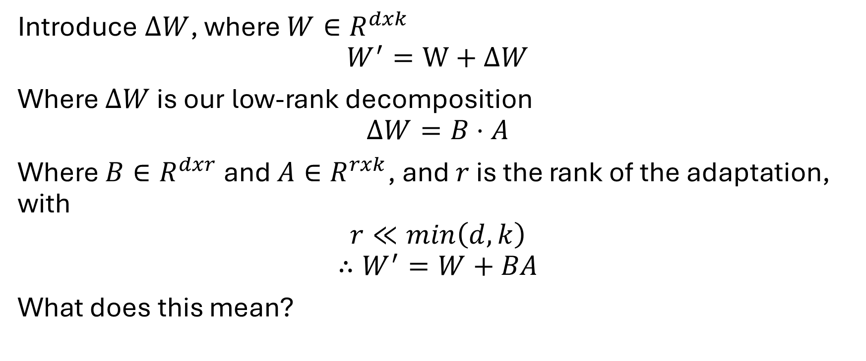
Adding a Low-Rank Adaption
Introduce $ΔW$, where $W∈R^{dxk}$
$$W^{′}=W+ΔW$$
Where $ΔW$ is our low-rank decomposition
$$ΔW=B⋅A$$
Where $B∈R^{dxr}$ and $A∈R^{rxk}$, and $r$ is the rank of the adaptation, with
$$r≪min\left(d,k\right)$$
$$∴W^{′}=W+BA$$
What does this mean?

Slide 9
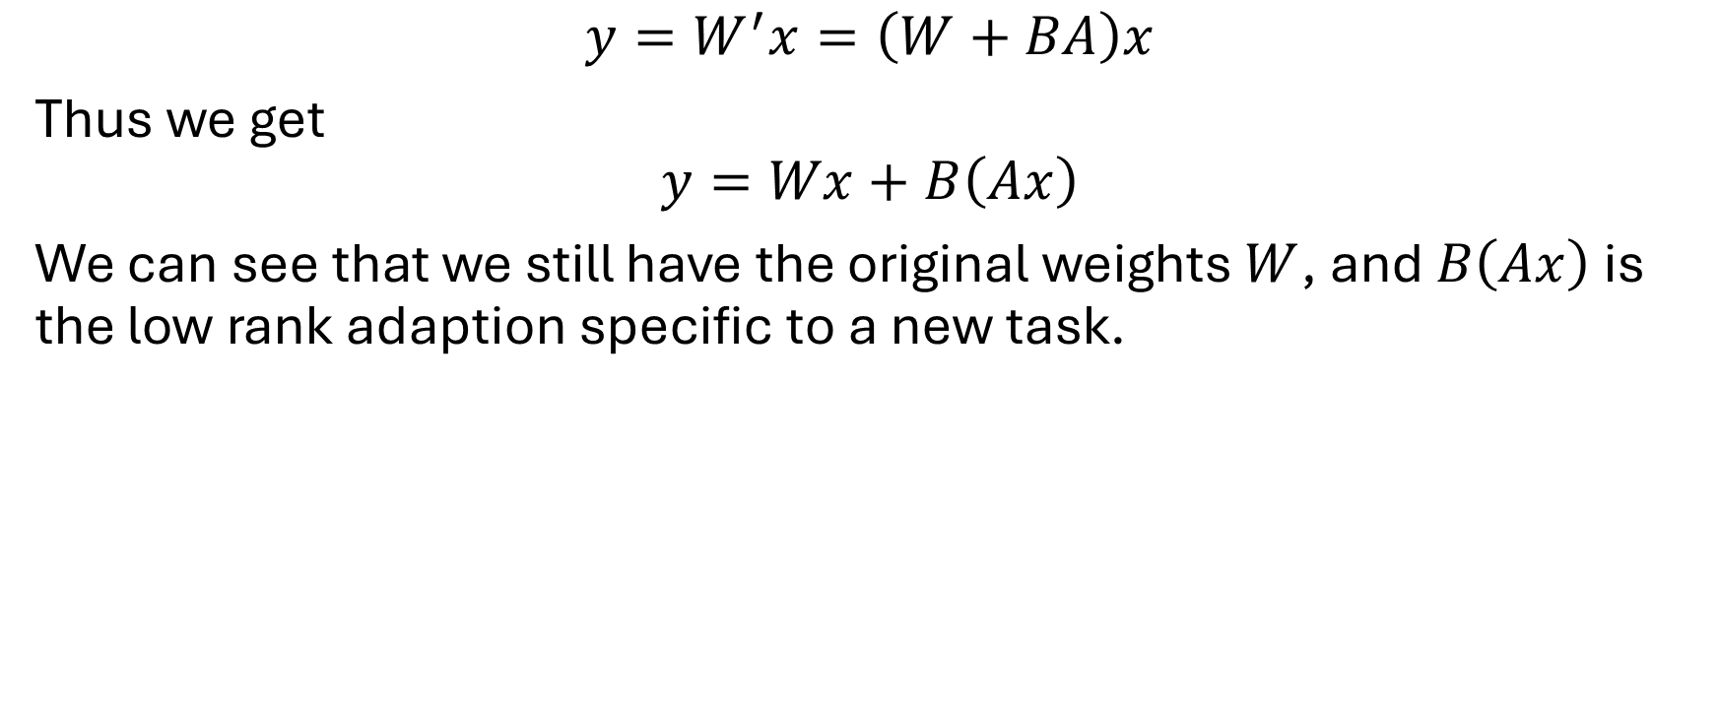
Forward Pass with Adaptation
$$y=W^{′}x=\left(W+BA\right)x$$
Thus we get
$$y=Wx+B\left(Ax\right)$$
We can see that we still have the original weights $W$, and $B\left(Ax\right)$ is the low rank adaption specific to a new task.

Slide 10
Section 5: Empirical Results

Slide 11
Empirical Results of LoRa on Stable Diffusion
Experimental Environment
Stable diffusion uses 100% of available resources
# of parameters changed varies from LoRa to LoRa
Thus, time to complete forward pass is the only realistically measurable result.
We can also subjectively view the results of LoRa.
All factors were held constant other than the inclusion of LoRa.

Slide 12
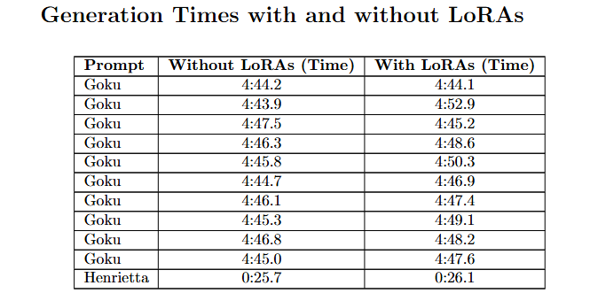
LoRa did not significantly change generation time through trials:

Slide 13



Slide 14



Sanity Check
Official Character
W/out LoRa
W/ LoRa

Slide 15
Section 5: Conclusion

